Slide 1
IMC: Non-Traditional Marketing

Slide 2
Overview
Sponsorships
Event Marketing
Product Placement
Guerrilla Marketing
Branded Entertainment
Influencer Marketing

Slide 3
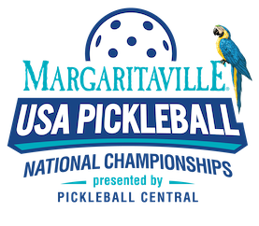
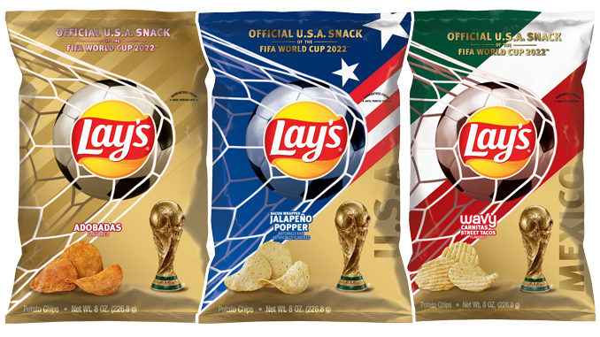

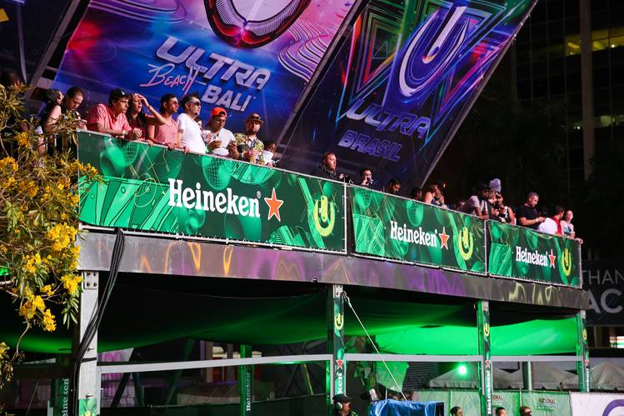
Sponsorships

Slide 4
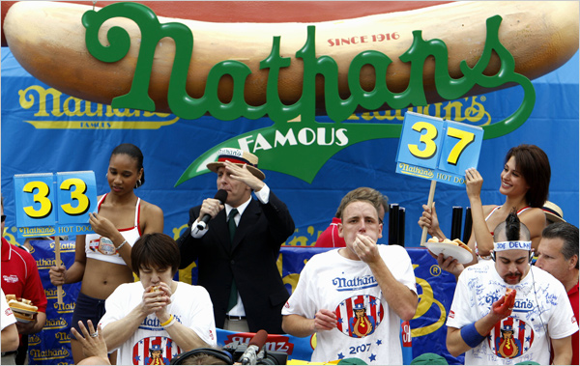
Event Marketing

Slide 5
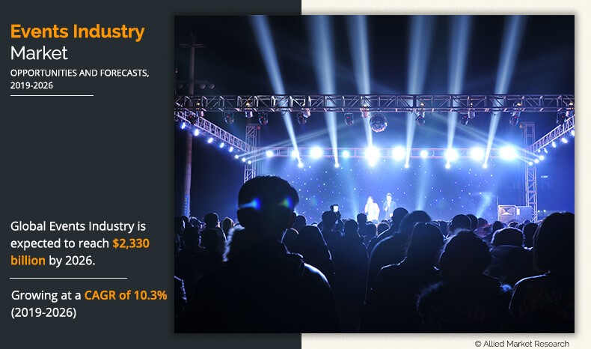
Robust Growth in Event Marketing

Slide 6
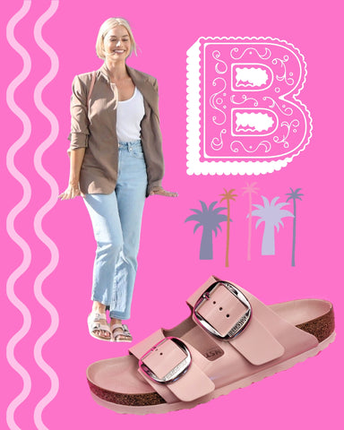
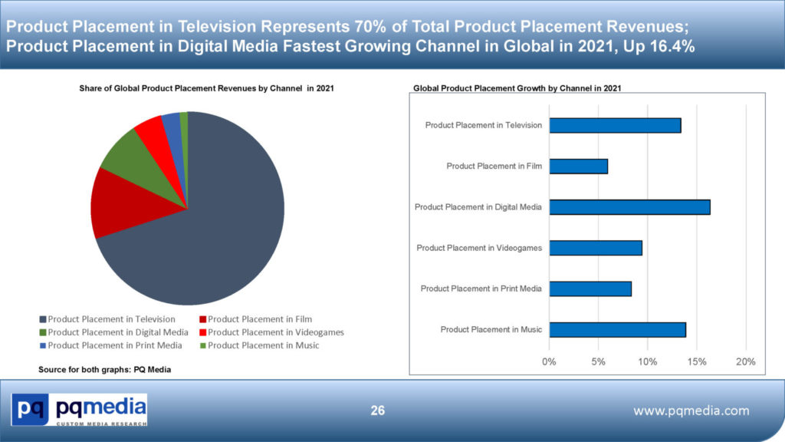
Product Placement

Slide 7
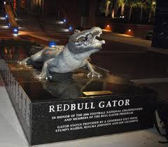
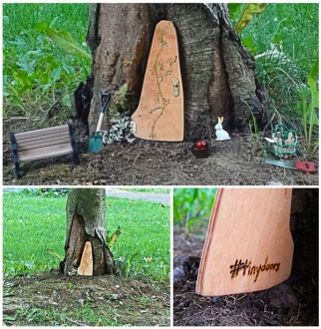
Guerrilla Marketing

Slide 8
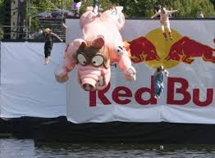

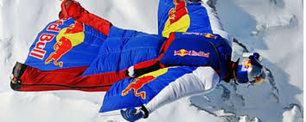
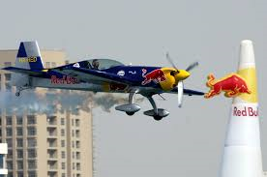
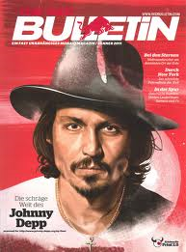
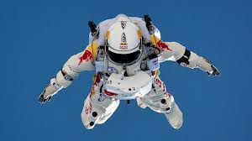
Branded Entertainment

Slide 9
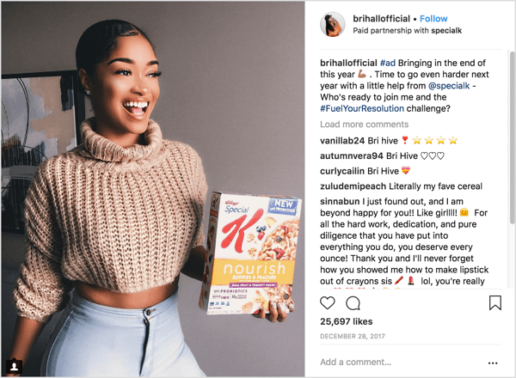


Influencer Marketing

Slide 10
Conclusion
Does your company utilize any non-traditional marketing tools?
If so, are they integrated with the other elements in the traditional promotional mix?
How is the effectiveness of any non-traditional marketing vehicles assessed?

Slide 11
End of Lecture

